Slide 1
Introduction to Q-Learning
Name: Muhammad Sohaib bin Kashif
Supervisor: G/Cp Salman
Date: 19th November 2021

Slide 2
Contents
About Machine Learning
Types of ML Algorithms
What is Q-Learning?
“Reinforcement Learning Tutorial Part 1: Q-Learning” (By Juha Kiili)
“The Accountant and the Gambler” Example
Assumptions of each scenario
Implementations: Variables and Functions
Running of the Code (Videos)

Slide 3
About Machine Learning
“The field of study that gives computers the ability to learn without being explicitly programmed.”
In Mathematical Terms:
“A computer program is said to learn from experience E with respect to some class of tasks T and performance measures P. If its performance at tasks in T, as measured by P, it improves with experience E.”
(Mitchell, T (1997), Machine Learning, McGraw Hill.)
Three Components involved with Learning:
E -> Learning aspect of the algorithm from available data
T -> e.g. Classification, Regression, or Ranking data
P -> Criteria to judge performance of a model e.g. Accuracy, Recall, Precision

Slide 4
Types of Machine Learning Algorithms
Supervised Learning
Unsupervised Learning
Reinforcement Learning
Q-Learning

Slide 5
What is Q-Learning?
Q-learning is a ‘values-based’ learning algorithm, which updates the value function based on an equation (particularly Bellman equation)
‘Q’ in Q-learning stands for ‘quality’ (how useful a given action is in gaining some future reward!)
In Mathematical Terms:
Value of an action = Immediate value + sum of all optimal future actions
“Simplest form of Reinforcement Learning, since it’s ‘Model-Free’ ”
Useful in situations with insufficient training data

Slide 6
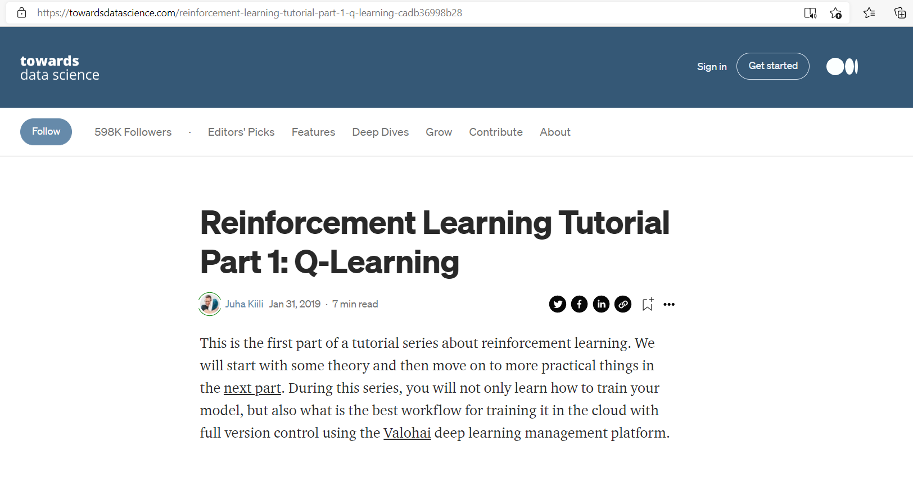

Slide 7

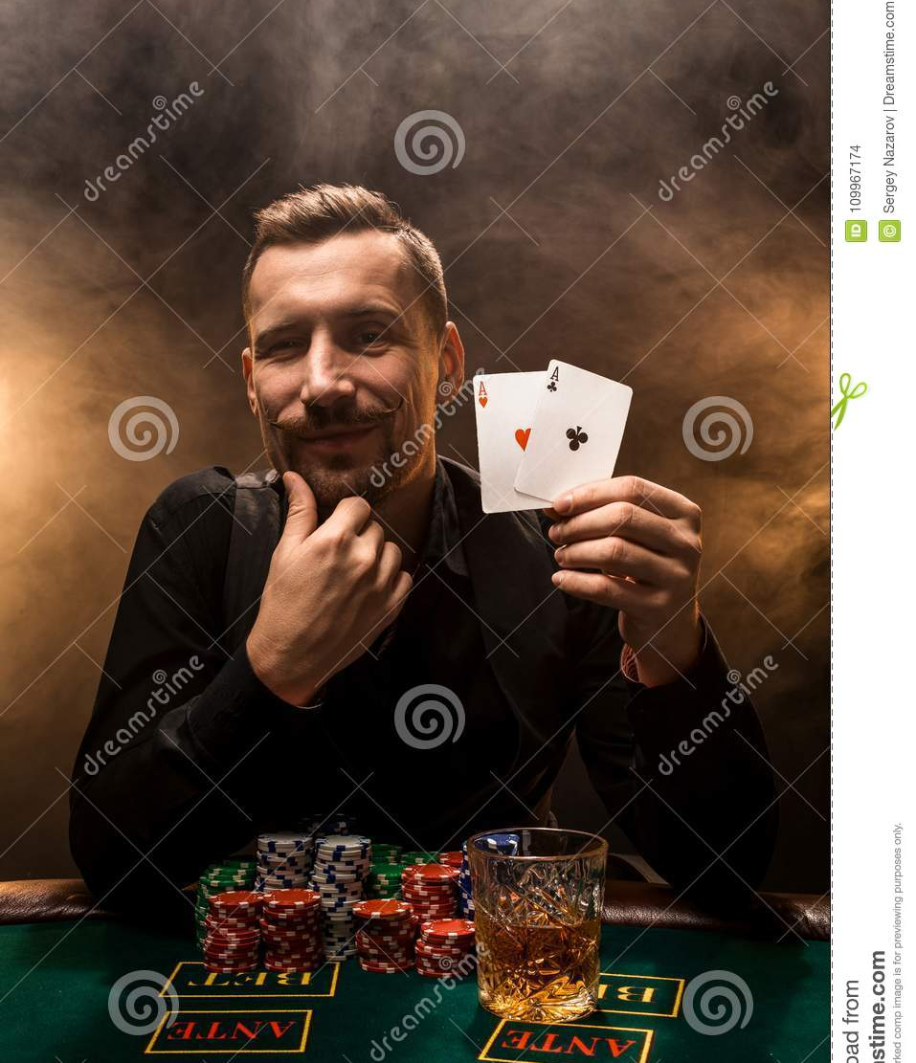
The Accountant vs The Gambler

Slide 8
The Accountant
Assumptions:
Dungeon is 5 tiles long.
Moves: {FORWARD, BACKWARD}
FORWARD: Moves a tile to the right
BACKWARD: Moves back to the leftmost tile
Rewards:
Moving to the last tile -> +10 points
Moving back to the first tile -> +2 points
No rewards on the other tiles
Target: 10 points

Slide 9
The Accountant (Cont.)
Implementation:
Variables:
Moves (Array)
Rewards (Array)
Dungeon (Array)
i and idx (Global Variables) + (Index for the Dungeon)
Target and Reward (Local Variables) + (Goal: Reward >= Target)
Functions:
Choices (Selects from the Moves Array)
Randomize (Creates Random Choices after every delay, once you give our choice)
Forwards and F_Movement (Moves the Accountant forward)
Backwards and B_Movement (Moves the Accountant backward)
Reward_Count (Checks the tiles and accumulates the rewards)

Slide 10
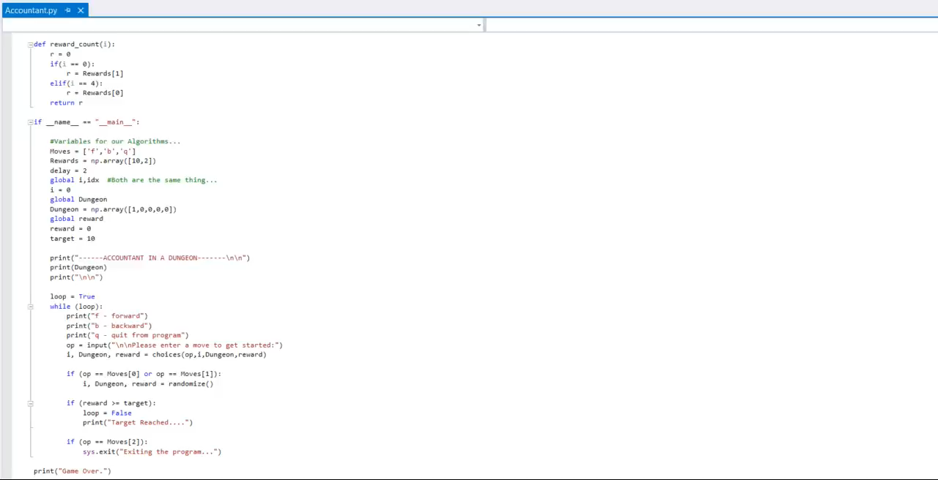
The Accountant (Cont.)

Slide 11
The Gambler
Assumptions:
Dungeon is 5 tiles long.
Actions: {RANDOMIZE, GAMBLE}
RANDOMIZE: Create random Moves
GAMBLE: User inputs a move from the Moveset.
Moves: {FORWARD, BACKWARD}
FORWARD: Moves a tile to the right
BACKWARD: Moves back to the leftmost tile
Rewards:
Moving to the last tile -> +10 points
Moving back to the first tile -> +2 points
No rewards on the other tiles
Target: 10

Slide 12
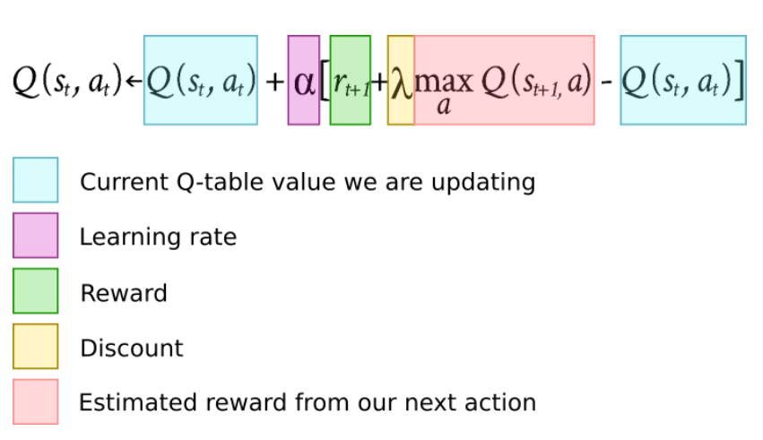
The Gambler (Cont.)
Assumptions:
QTABLE: Values updated based on the states of the Gambler in the Dungeon
Values updated by the formula:

Slide 13
The Gambler (Cont.)
Start with 100% gambling (exploration), move slowly toward 0%
Use discount = 0.95
Use learning rate = 0.1
Why Gamble? Explore more options in the Dungeon

Slide 14
The Gambler (Cont.)
Implementation:
Variables:
Moves (Array)
Actions (Array)
Rewards (Array)
Dungeon (Array)
Qtable (Array)
i and idx (Global Variables) + (Index for the Dungeon)
Target and Reward (Local Variables) + (Goal: Reward >= Target)
Learning_Rate (Local Variable)
Discount (Local Variable)

Slide 15
The Gambler (Cont.)
Implementation:
Functions:
Actions (Randomize or Gamble?)
Randomize (Creates Random Choices after every delay, once you give our choice)
Gamble (Forces a Choice)
Choices (Selects from the Moves Array)
Forwards and F_Movement (Moves the Accountant forward)
Backwards and B_Movement (Moves the Accountant backward)
QTable_Score (Updates the QTable in case of any Rewards)
Reward_Count (Checks the tiles and accumulates the rewards)

Slide 16
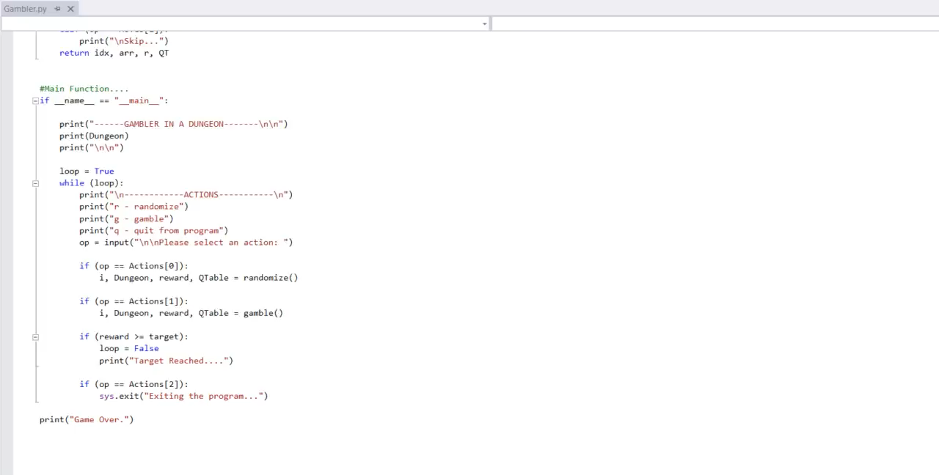
The Gambler (Cont.)

Slide 17
CONCLUSION

Slide 18
References
Reinforcement Learning Tutorial Part 1: Q-Learning | by Juha Kiili | Towards Data Science

Slide 19
Appendix

Slide 20
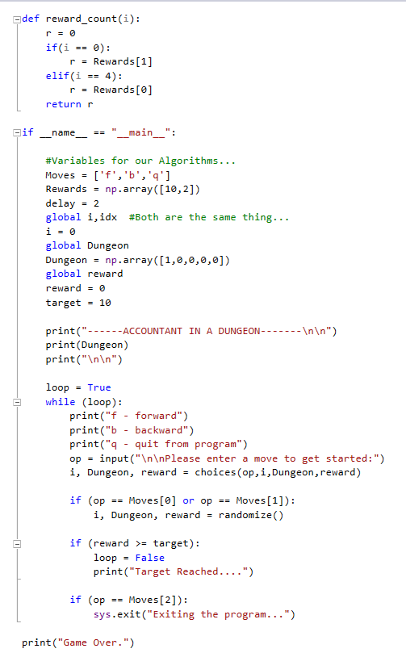
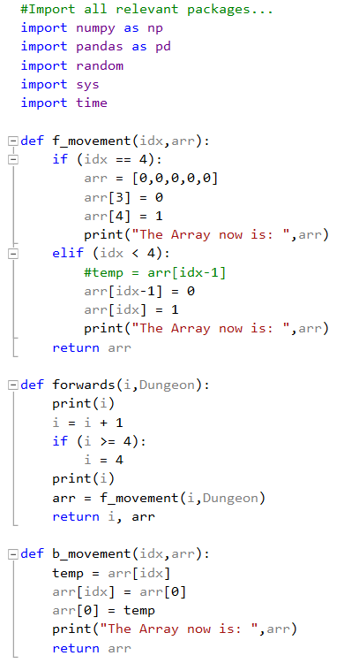
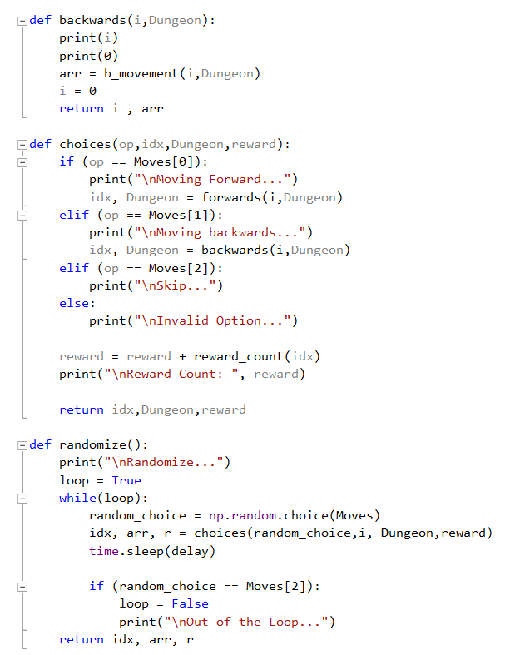
Appendix A: ‘Accountant’ Code

Slide 21
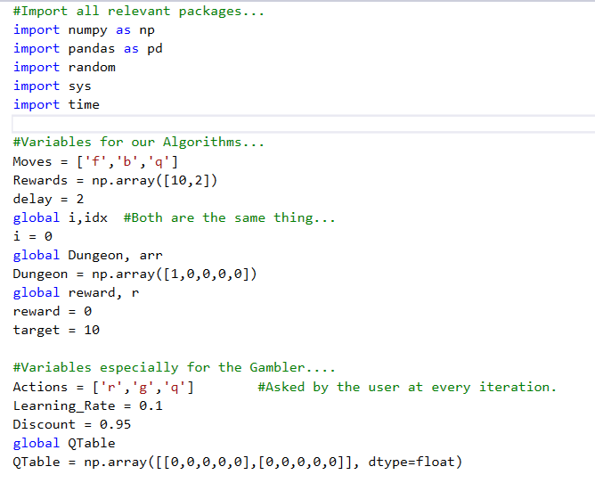
Appendix B: ‘Gambler’ Code

Slide 22
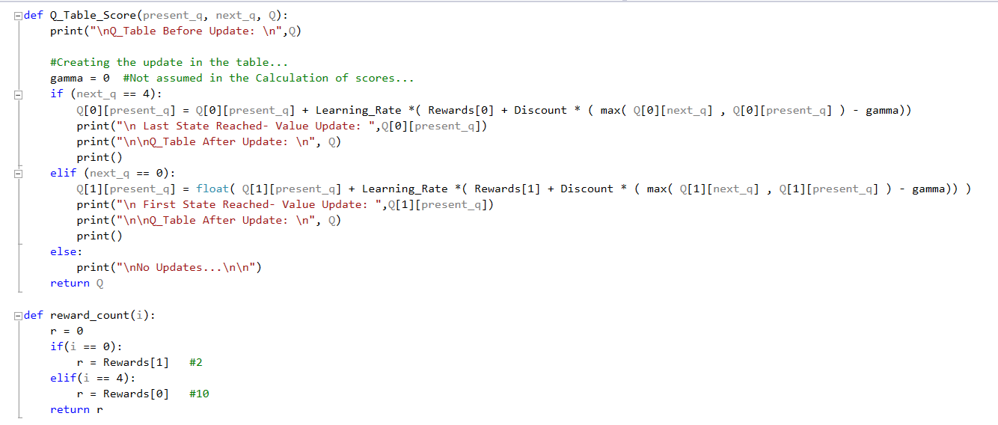
Appendix B: ‘Gambler’ Code (Cont.)

Slide 23
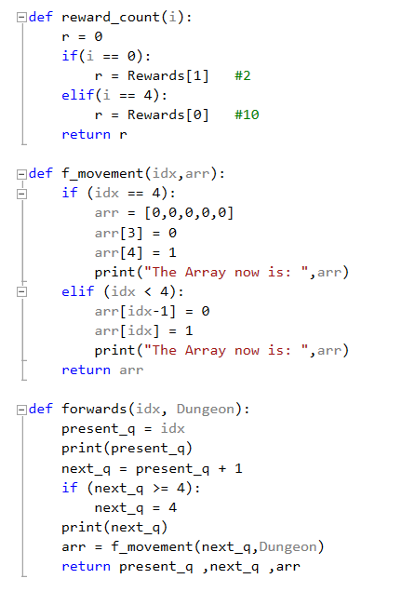
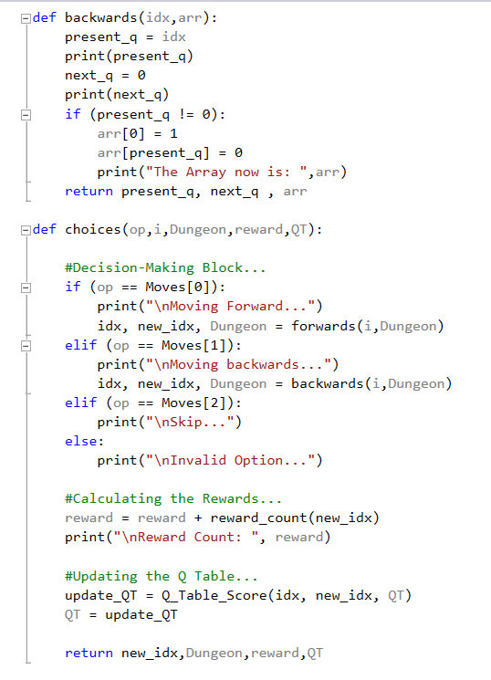
Appendix B: ‘Gambler’ Code (Cont.)

Slide 24
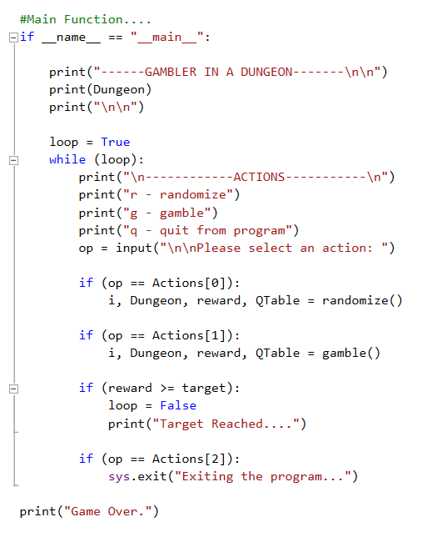
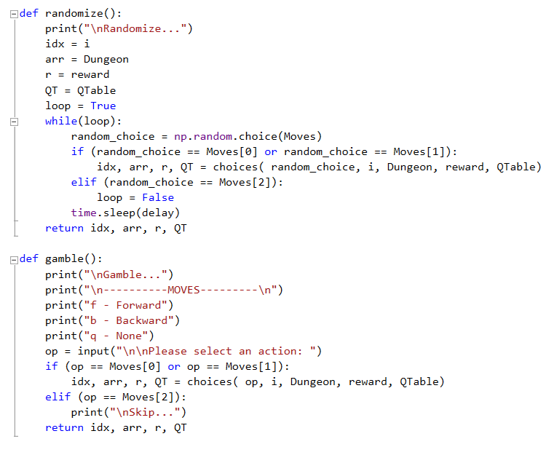
Appendix B: ‘Gambler’ Code (Cont.)

